Slide 1



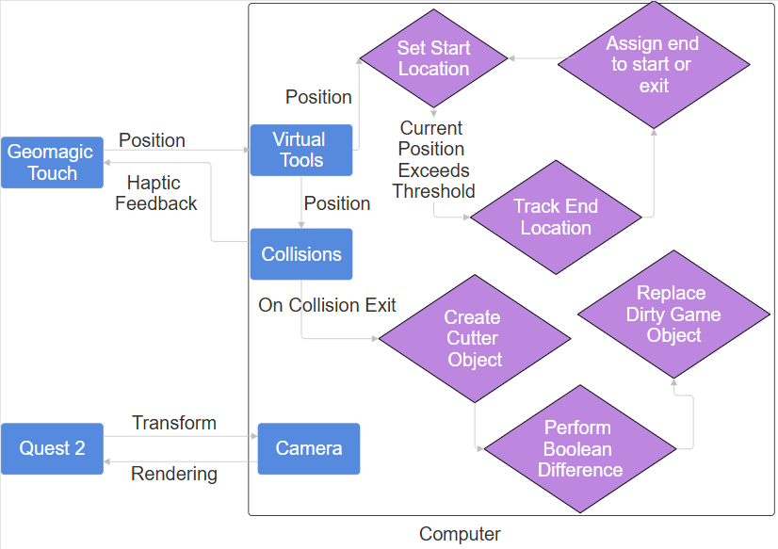
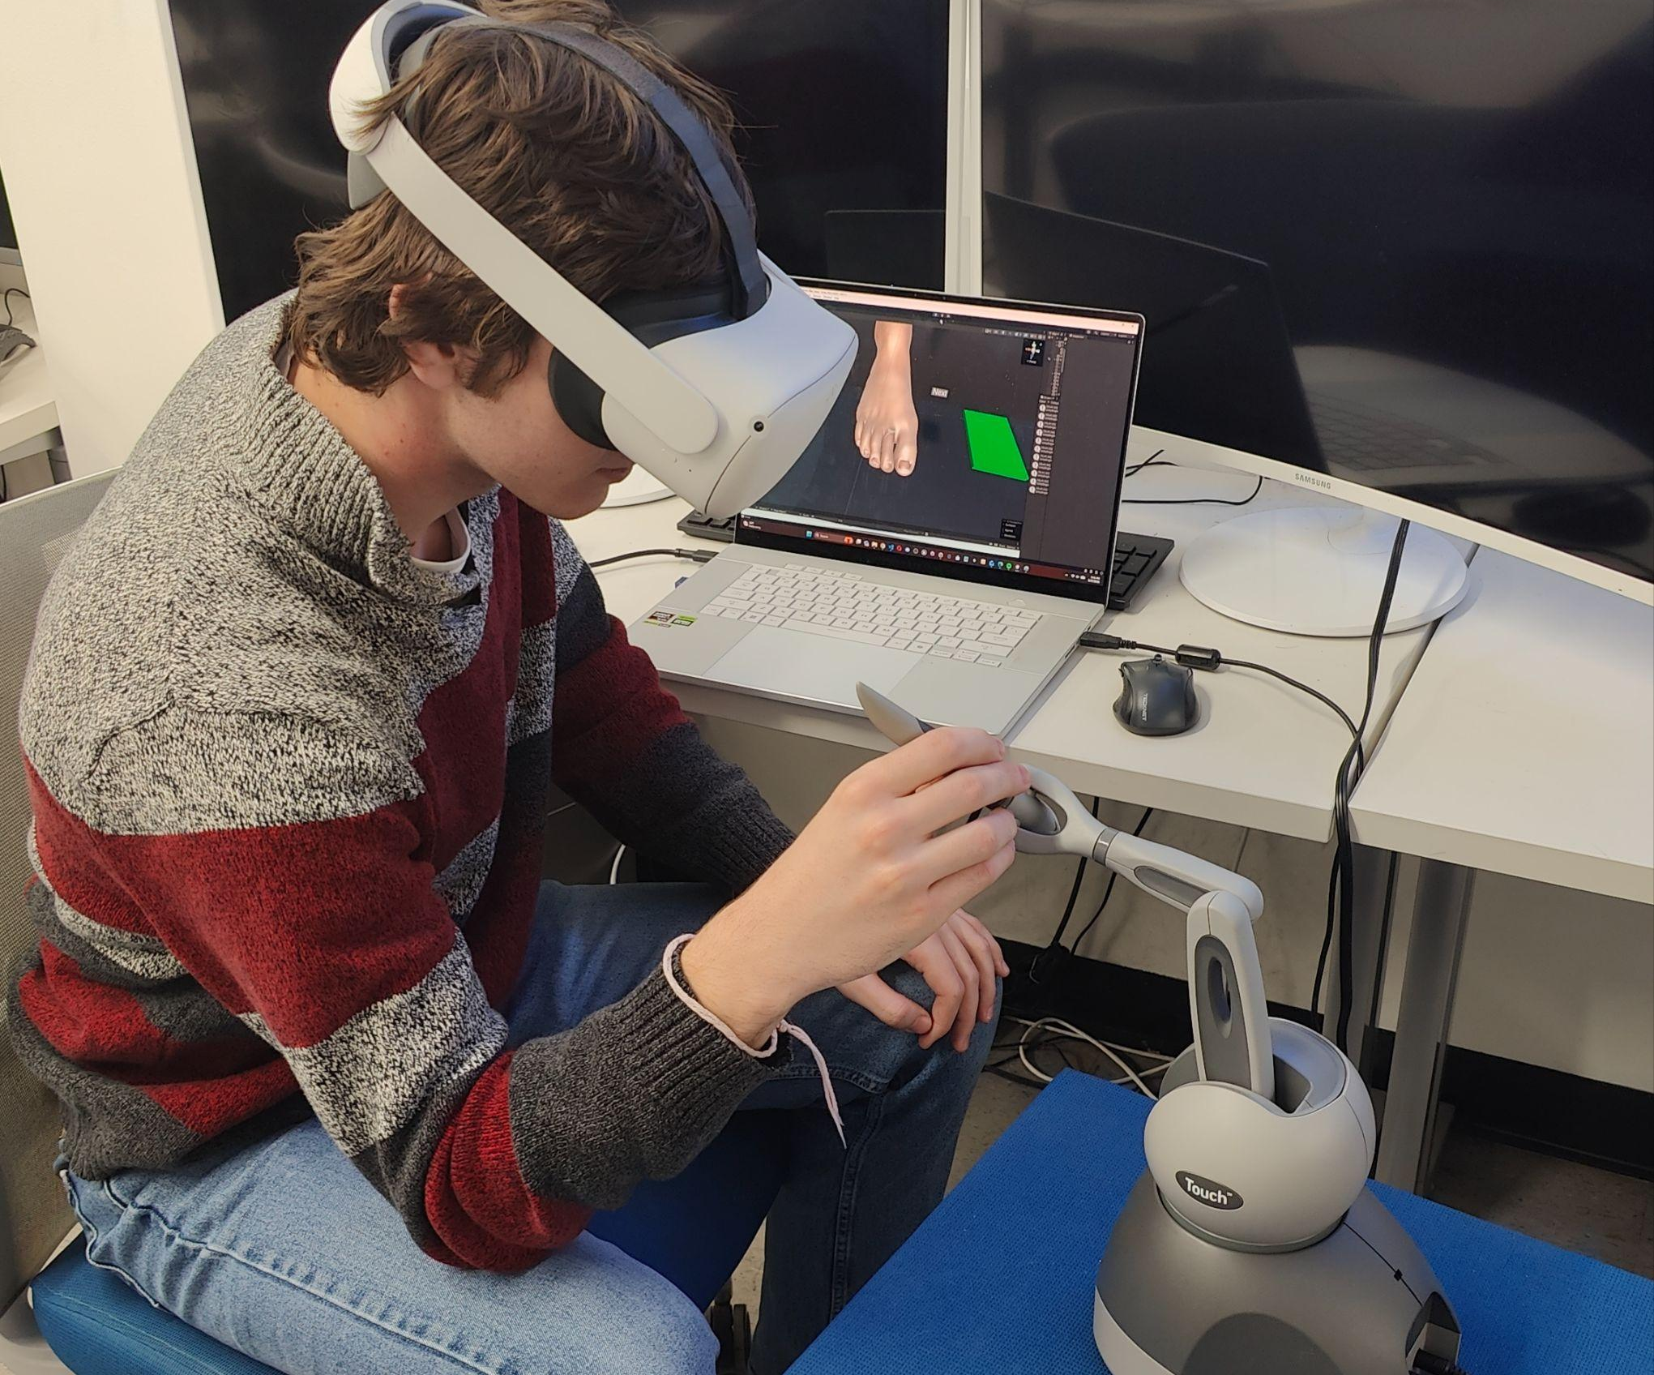
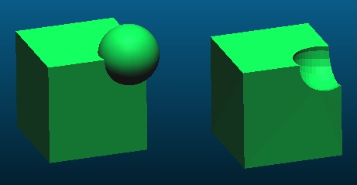
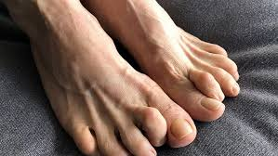
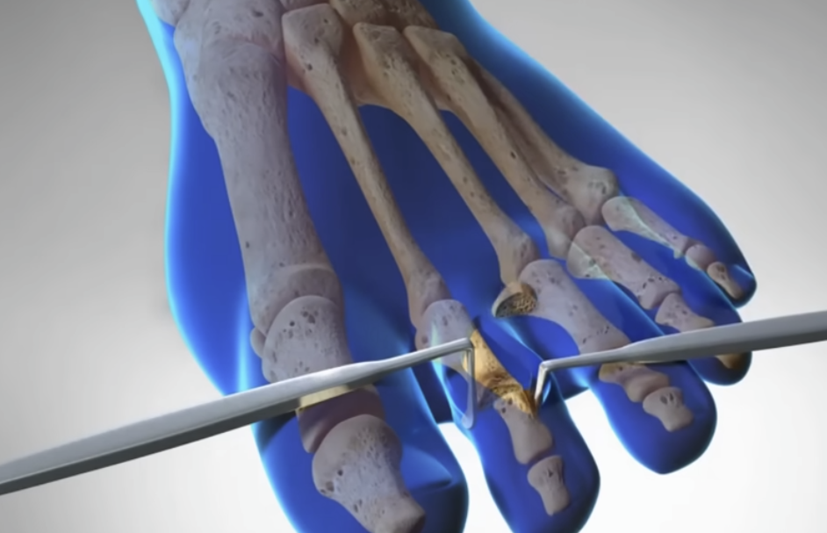
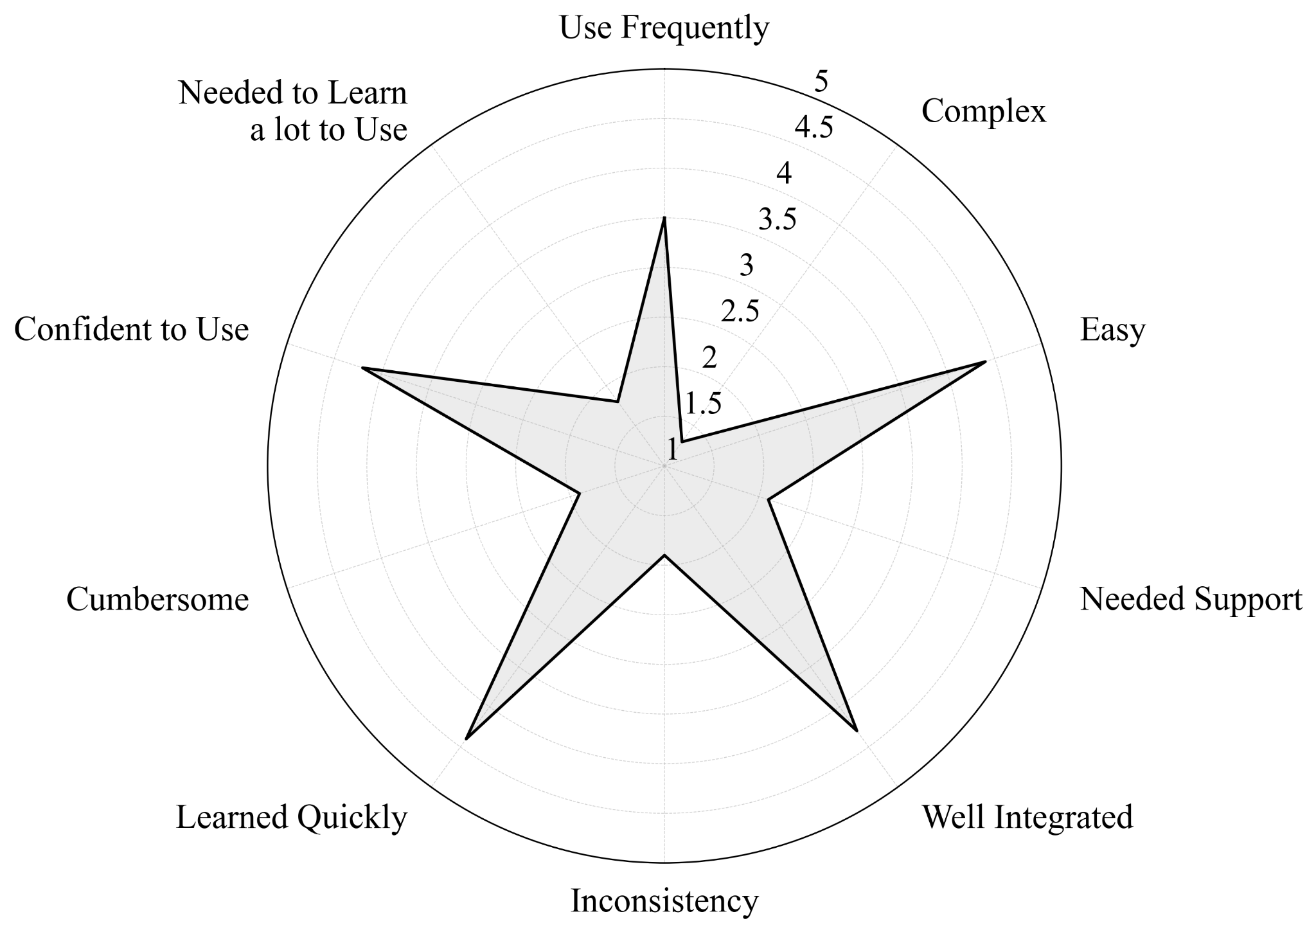
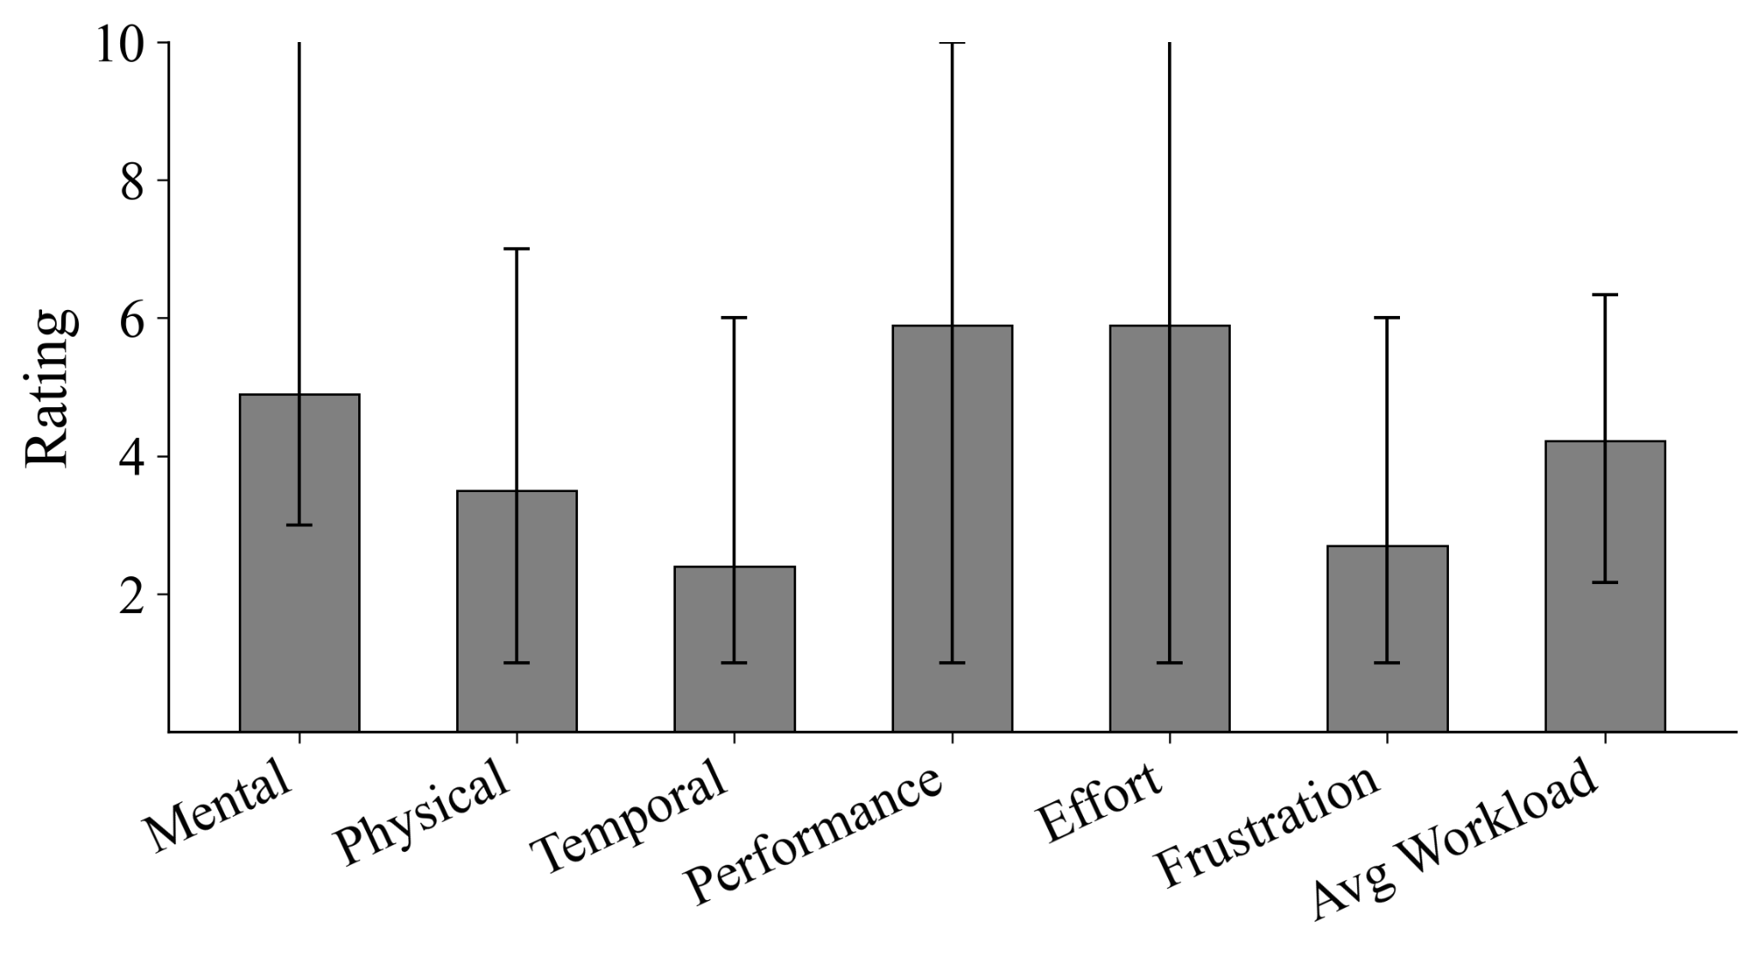
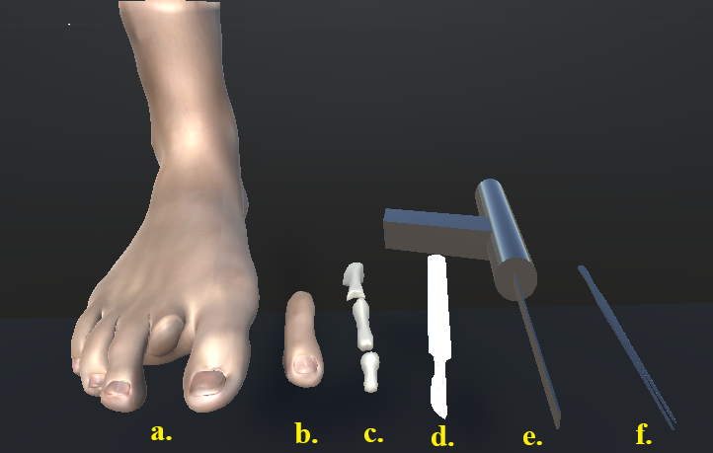
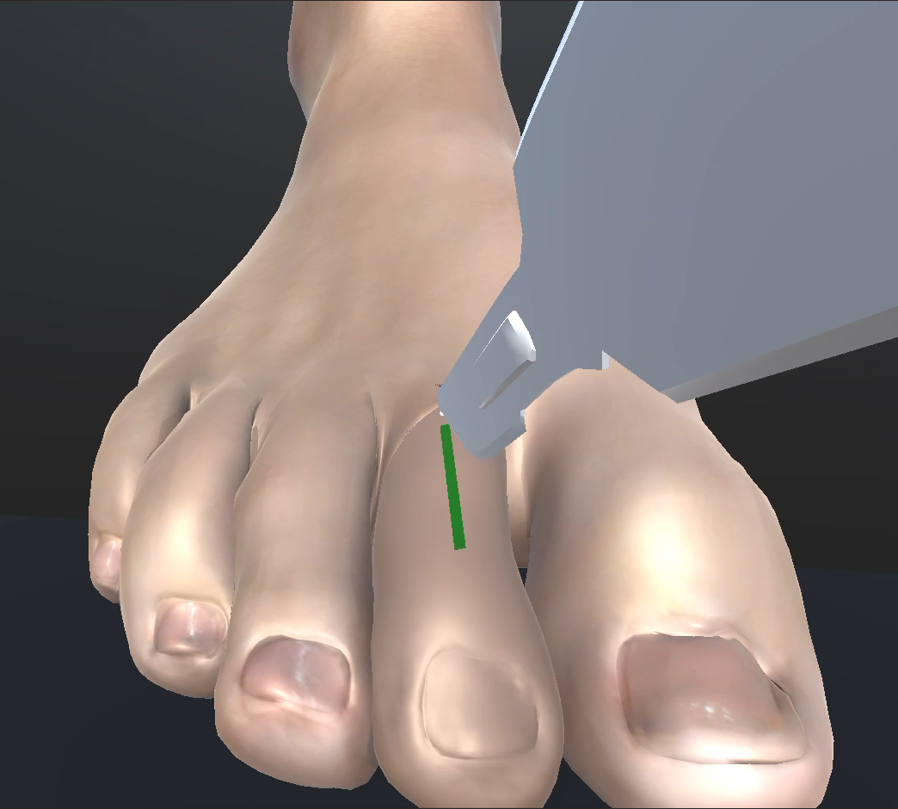
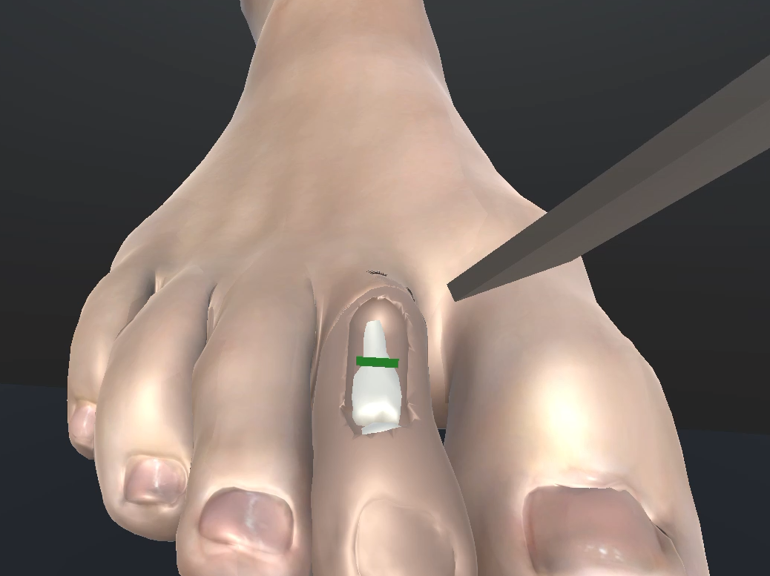
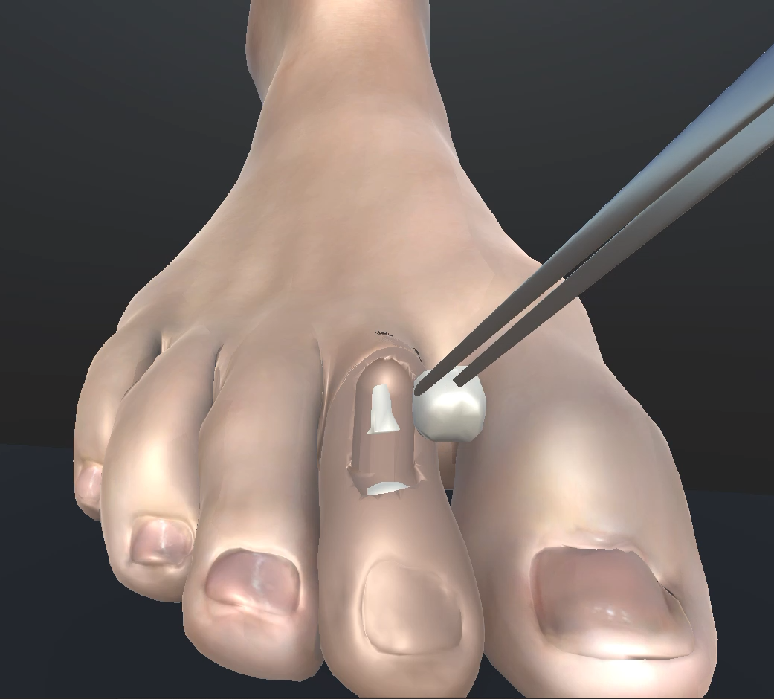
Initial Study of VR Haptic Multi-Level Scalpel Incision Simulation
Immersive Computing for Touch Lab Presents:
SUS & NASA TLX Graphs,
Joseph Demore
Advised By,
Dr. Kwangtaek Kim
Isaac Hraga
Introduction
Experiment Results
Problem
Hammer toe correction via Proximal Interphalangeal Joint (PIP) arthroplasty requires precise force modulation during soft-tissue incision and bone resection. No dedicated simulation platform exists for this procedure; trainees rely on cadavers and supervised OR exposure, both constrained by cost and availability.
Participants
N=10 (mean age 22.7 yrs, SD 4.6; 7M/3F; no visual or tactile impairments; no prior medical training or simulator exposure). Each completed 10 trials across all three subtasks.
System Performance
Mean FPS | FPS SD | Session Failutes
72.4 | 2.9 | 0
Participant using VR and Haptic Device
Boolean Mesh Operation (top) System Design Flow Chart (right)
Usability and Workload
SUS mean | NASA TLX mean | SUS > 70
79.5 | 5.2/21 | 8/10
Mesh Manipulation using Computational Geometry Algorithm Library (CGAL) [2]
Cutter segments are accumulated post-gesture into a single swept volumetric mesh, then Boolean difference is applied asynchronously to prevent main-thread blocking. Three pre-operation validation steps:
Deduplication of points within 1×10⁻⁴ m
Closure check (manifold mesh)
Self-intersection test via CGAL routines
On failure, the operation is aborted without modifying the target mesh. Pre/post states are serialized to OBJ for reproducibility.
Hammer toe deformity(left) [1], Simulated procedure(right) [1]
SUS
NASA TLX
Objective
Develop a haptic-augmented VR simulator for the incision, resection, and fragment removal phases of hammer toe correction and evaluate its feasibility for procedural skill training.
Haptic and VR Rendering
Geomagic Touch (3DOF, max 3.3 N, workspace 160×120×70 mm) + Meta Quest 2 (6-DOF, 1832×1920/eye, 72 Hz). Force rendered from proxy collider penetration depth via Haptics Direct. Haptic and visual loops are decoupled to prevent frame-rate variation from introducing force discontinuities. Models are given variable haptic material parameters to model the tool responses to different models.
Medical Procedure (with Joint Resection)^{[1]}
Incisions are made to release the tendons holding the toe
The end of one bone is removed so the toe can be fully straightened
If fusion is required, bone is removed from both sides of the affected joint to restore alignment, allowing the bones to fuse together in the healing process
A pin is placed through the bones and out of the toe to maintain the straightened position throughout the healing process
The scalpel incision is stitched and the pin is capped outside of the toes
Parameter | Skin | Bone (Scalpel) | Bone (Saw)
Stiffness | 0.855 | 1.0 | 0.5
Viscosity | 0 | 1 | 3
Static Friction | .95 | 1.0 | 0.3
Dynamic Friction | 0.95 | 1.0 | 048
SUS [3] Average Radial Chart
NASA TLX [4] average graph
Scalpel Accuracy Averages
Average Dev. | Start Error | End Error
2.04 mm | 3.73 mm | 5.92 mm
Model | Foot | Toe | Phalanx | Scalpel | Saw | Foreceps
Vertex Count | 6,617 | 798 | 139-363 | 344 | 206 | 2650
Bone Resection Accuracy Averages
Average Dev. | Start Error | End Error
2.04 mm | 5.37 mm | 29.93 mm
Method
Fragment Removal
Bad Grab Totals | Range per participant | Deposit Success
91 | 2 - 17 | 98%
Simulation Development:
Three sequential subtasks: scalpel incision, reciprocating saw resection, forceps fragment removal.
Scalpel: cut points appended at >0.3 mm displacement; visual start/end/path guides overlaid
Saw: collision-driven; blade extruded at exit to form cutter; visual start/end/path guides overlaid
Forceps: proximity-triggered parenting; button press grabs/releases fragment; BoneDeposit event logged on successful deposit
Conclusion:
Stable performance
Strong baseline precision
Large full-stroke drift likely due to missing visual resection guide, not user skill limitations.
Numerous bad grab events indicate collider mismatch, impact of usability was limited
High usability and low cognitive load.
Strong preference for scalpel haptics; suggested improvements include camera control, tool switching, and incision visualization.
References:
[1] Health Decide. Hammer toe correction. Resurgens Orthopaedics; 2023.
[2] Scrawk J. CGALDotNet. GitHub; 2026.
[3] AHRQ. System Usability Scale (SUS). 2026.
[4] NASA. Task Load Index (TLX) Scale. 2026.
Future Work
mesh-fitted forceps collider, resection plane guide, visible skin deformation, and extension to realignment and fixation phases.
Models (top left), Scalpel Incision (top right), Bone Resection (bottom left), Fragment removal (bottom right)
Notes:
Arthroplasty - joint replacement surgery

